Slide 1

Status Report
Julian Meyringer, Matthias Puchner, Moritz Famira, Anton Schubhart

Slide 2
Description
Merchandise Online Shop
Upload own Designs
Voting System for Communitydesigns

Slide 3
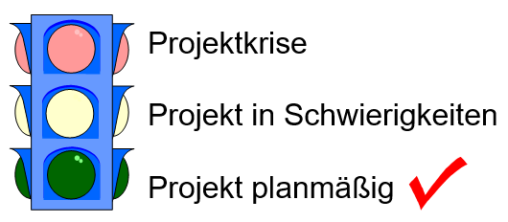

Slide 4
Work packages
1 MOS
1.1 Project Management
1.2 Planning
1.3 Backend Programming
1.4 Frontend Programming
1.5 Testing
1.1.1 start project
1.2.1 defining specifications
1.3.1 start ASP.NET project
1.4.1 adding login page
1.5.1 testing login
1.1.2 coordinate project
1.2.2 planning backend structure
1.3.2 write Database Queries
1.4.2 adding store page
1.5.2 testing ordering process
1.1.3 control project
1.2.3 deciding on website design
1.3.3 program submission file upload
1.4.3 adding submission page
1.5.3 testing submissions
1.1.4 finish project
1.3.4 write controllers
1.4.4 adding poll page
1.5.4 testing voting
1.3.5 ensuring password security
1.4.5 JS stuff

Slide 5
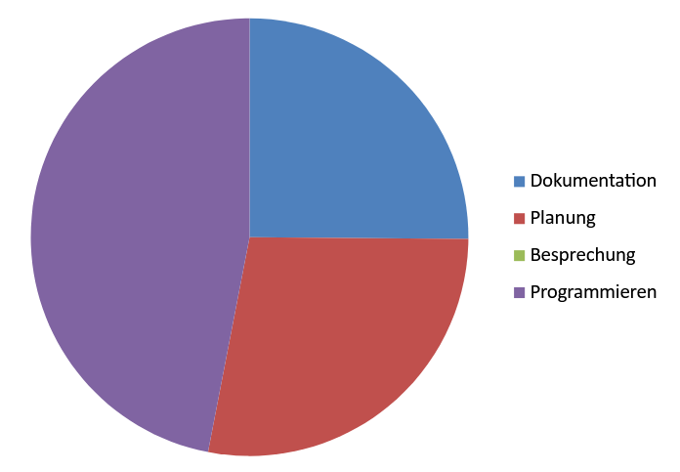

Slide 6
Problems
Database structure should be rethought
Frontend and Backend need coordination
Splitting work among team members

Slide 7
Reasons for no Meetings
We mostly communicate in school or via discord
No time due to tests, etc.
Meeting while planning or programming together

